Slide 1
Visual Analysis of Plans for Multi-Agent
Path Finding with Continuous Time
(MAPF-R)
Evgenii Abdalov

Slide 2
Main goal
The design and development of a visualization tool
for multi-agent pathfinding problem
with continuous time
that enables its visual analysis

Slide 3
Main tasks
To study relevant literature on MAPF-R problem and identify aspects deserving visualization
To design and implement visualization tool of MAPF-R plans
To provide documentation to enable future upgrades
To analyze economic potential of the visualization tool in logistic domains

Slide 4
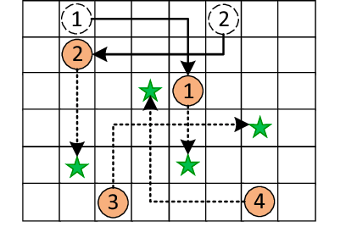
MAPF problem

Slide 5
MAPF problem input
Graph G = (V,E),
Collection of starting points s : [1, ...., k] for k agents,
Collection of target points t : [1, ...., k] for k agents

Slide 6
MAPF problem
Agent action can be MOVE or WAIT,
Single-agent plan π = (a1, ...., an), that leads agent i from s[i] to t[i],
MAPF problem output: collection of plans π = (π1, ...., πk)

Slide 7
MAPF-R problem
MAPF-R problem is a MAPF problem, where agent motion is planned for a certain time interval,
Discrete time: (a, v, t); t → time step,
Continuous time: (a, v, t); t → time interval

Slide 8
MAPF-R visualization tool concept
Front end application for precalculated solutions
Enables visual analysis tools
Main objectives: ANIMATION and GUI

Slide 9
MAPF-R visualization tool purpose
MAPF-R problem solution quality evaluation
Discovery of unknown events, that could be detected by visualizing the solution
Solution verification, i.e. if agent plans are correctly solved

Slide 10
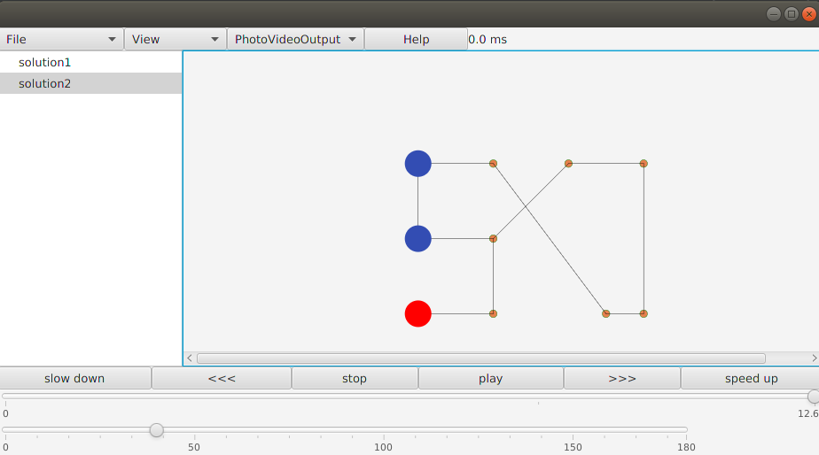
MAPF-R visualization tool

Slide 11
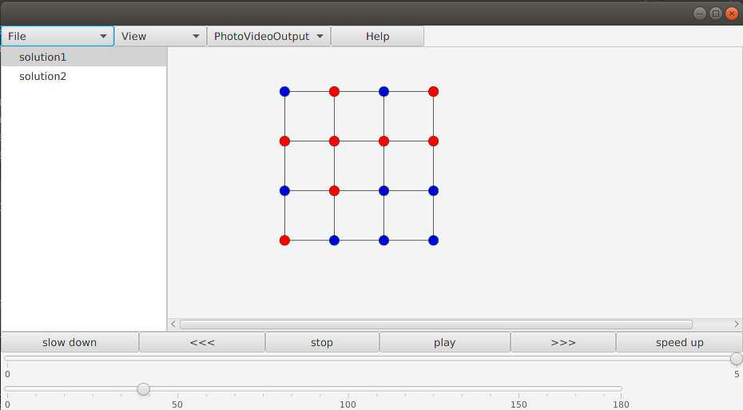
MAPF-R visualization tool

Slide 12
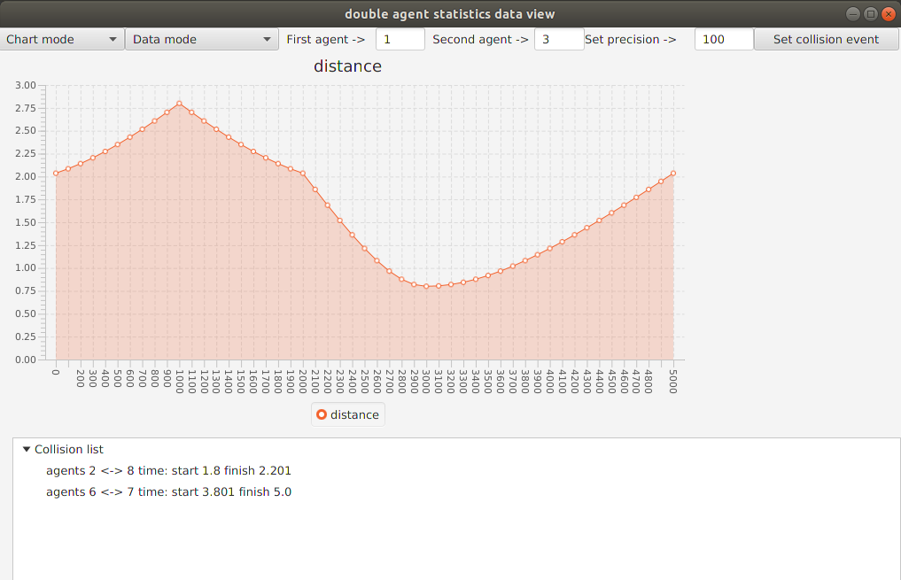
MAPF-R problem analysis

Slide 13
MAPF-R problem analysis
Collision events detection
Rate of collision risk assessment
Safe distance assessment
Shortest paths detection

Slide 14
Economic evaluation results shoop floor
More precise goods redistribution system
Faster actual problem detection system
More accessible problem representation for workers

Slide 15
Economic evaluation results higher management
More precise strategic planning
Systematic mistakes detection system
Detection of weak scheduling patterns
Great presentational tool

Slide 16
Thank you for your attention

